Slide 1

Hands-On Ethical Hacking and Network Defense, Edition 4
Module 10: Hacking Web Servers
Simpson, Antill, Wilson, Hands-On Ethical Hacking and Network Defense, 4th Edition. © 2023 Cengage. All Rights Reserved. May not be scanned, copied or duplicated, or posted to a publicly accessible website, in whole or in part.

Slide 2
Module Objectives
By the end of this module, you should be able to:
Describe web applications
Explain web application vulnerabilities
Describe the tools used to attack web servers

Slide 3
Understanding Web Applications
Writing a program without bugs is difficult
Some defects create security vulnerabilities
The bigger the program, the more bugs or defects are possible
The more people who have access to a program, the bigger the risk of security vulnerabilities

Slide 4
Web Applications Components
Static webpages
Created using HTML
Display the same information regardless of the time of day or the user who accesses the page
Dynamic webpages
Information that is displayed varies
Need special components for displaying information that changes depending on user input or information from a back-end server
Use a variety of tools
<form> element, Asynchronous JavaScript and XML (AJAX), Common Gateway Interface (CGI), Active Server Pages (ASP.NET), Java Server Pages (JSP), Hypertext Preprocessor (PHP), ColdFusion (CF), JavaScript (JS), and database connector strings

Slide 5
Web Forms (1 of 3)
Use the <form> element in an HTML document
To allow customers to submit information to the web server
Some forms can be quite long and ask for a lot of information
Some have only a couple of input fields
Web servers
Use a web application to process information from a form

Slide 6
Web Forms (2 of 3)
Web form example:
<html>
<body>
<form>
Enter your username:
<input type="text" name="username">
<br>
Enter your password:
<input name="password" type="password">
</form></body></html>

Slide 7
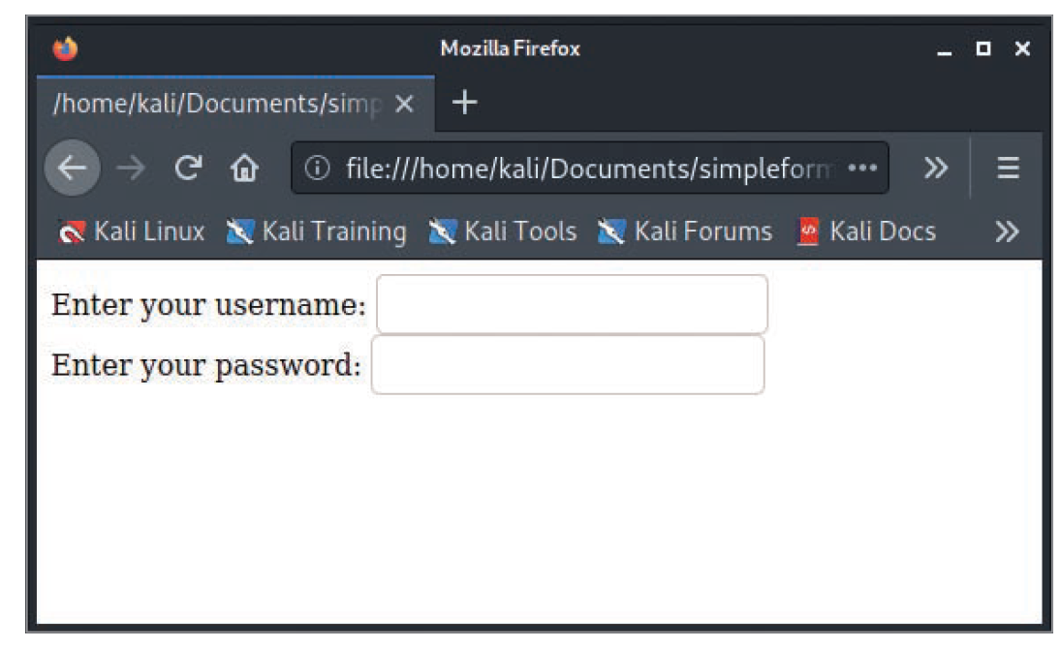
Web Forms (3 of 3)
Source: Mozilla Firefox
Figure 10-1 HTML webpage with a form

Slide 8
Common Gateway Interface (CGI) (1 of 2)
Handles moving data from a web server to a web browser
Enables web designers to create dynamic HTML web applications
Many dynamic webpages are created with CGI and scripting languages
Interface that determines how a web server passes data to a web browser
Relies on Perl or another scripting or programming language to create dynamic webpages
Main role
Passing data between a web server and web browser

Slide 9
Common Gateway Interface (CGI) (2 of 2)
CGI programs can be written in many programming and scripting languages
C/C++, Perl, UNIX shells, Visual Basic, and Java
CGI example displaying “Hello Security Testers” written in Perl:
#!/usr/bin/perl
print "Content-type: text/html\n\n";
print "Hello Security Testers!";

Slide 10
Third-Party Frameworks and Libraries
A few of the hundreds of frameworks designed to make programming easier:
Spring
JSF
AngularJS
Yeoman
Sass
Vaadin
As third-party libraries grow in popularity, keeping them current and secure becomes more important

Slide 11
Active Server Pages (1 of 2)
ASP and ASP.NET
Two other technologies that developers can use to display HTML documents to users on the fly
Has been succeeded by ASP.NET
Uses a compiled server-side language (such as C#) and the .NET framework
Enabled developers to build dynamic, interactive webpages using scripting languages
JScript
VBScript
Not all web servers support ASP or ASP.NET

Slide 12
Active Server Pages (2 of 2)
ASP example:
<html>
<head><title>My First ASP.NET Webpage</title></head>
<body>
<h1>Hello, security professionals</h1>
The date and time is <%=DateTime.Now %>.
</body>
</html>
Keep in mind that the web server, not the web browser, must support ASP

Slide 13
Apache Web Server
Apache
Another web server program
2021: Apache Web Server has 31.7% of the web server market share compared to 6.7% for IIS
Advantages
Works in just about any *nix and Windows platform
Free
Apache Web Server daemon (httpd) is included by default in Kali Linux

Slide 14
Using Scripting Languages
Web pages
Developed using several scripting languages
VBScript
JavaScript
Many security-testing tools are written with scripting languages
Most macro viruses and all worms that take advantage of cross-site scripting vulnerabilities are based on a scripting language

Slide 15
PHP Hypertext Processor (PHP) (1 of 2)
Enables creation of dynamic webpages
Similar to ASP and ASP.NET
An open-source server-side scripting language
Embedded in an HTML webpage by using the PHP tags <?php and ?>
Users cannot see PHP code on their web browser
Because PHP webpages run on the server
Originally used mainly on UNIX systems
More widely used now on many platforms, including Macintosh and Windows

Slide 16
PHP Hypertext Processor (PHP) (2 of 2)
Code example for a static PHP webpage showing the use of PHP tags:
<html>
<head>
<title>My First PHP Program </title>
</head>
<body>
<?php echo '<h1>Hello, Security Testers!</h1>"; ?>
</body>
</html>

Slide 17
Cold Fusion (1 of 2)
Server-side scripting language
Used to develop dynamic webpages
Created by Allaire Corporation
Now owned by Adobe Systems, Inc.
Uses proprietary tags
Written in ColdFusion Markup Language (CFML)
CFML web applications
Can contain other client-side technologies, such as HTML and JavaScript

Slide 18
Cold Fusion (2 of 2)
CFML example:
<html>
<head>
<title>Using CFML</title>
</head>
<body>
<CFLOCATION URL="www.isecom.org" ADDTOKEN="NO">
</body>
</html>

Slide 19
JavaScript (1 of 4)
Popular scripting language used for creating dynamic webpages
Has the power of a programming language
Branching
Looping
Testing
Creates functions and procedures in HTML webpages
Widely used
Variety of vulnerabilities have been exploited in older web browsers
Security testers and administrators should inspect every computer for unpatched or outdated browser versions
Keep up with vulnerabilities

Slide 20
JavaScript (2 of 4)
HTML snippet with JavaScript code:
<html>
<head>
<script type="text/javascript">
function chastise_user()
{
alert("So, you like breaking rules?")
document.getElementByld("cmdButton").focus()
}
</script>
</head>
<body>

Slide 21
JavaScript (3 of 4)
JavaScript example (continued):
<h3>"If you are a Security Tester, please do not click the command button below!"</h3>
<form>
<input type="button" value="Don't Click!" name="cmdButton"
onClick="chastise_user()" />
</form>
</body>
</html>

Slide 22
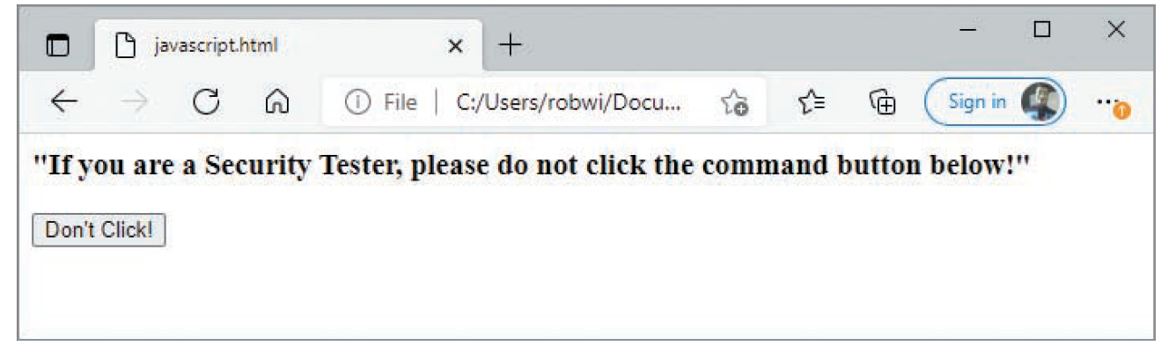
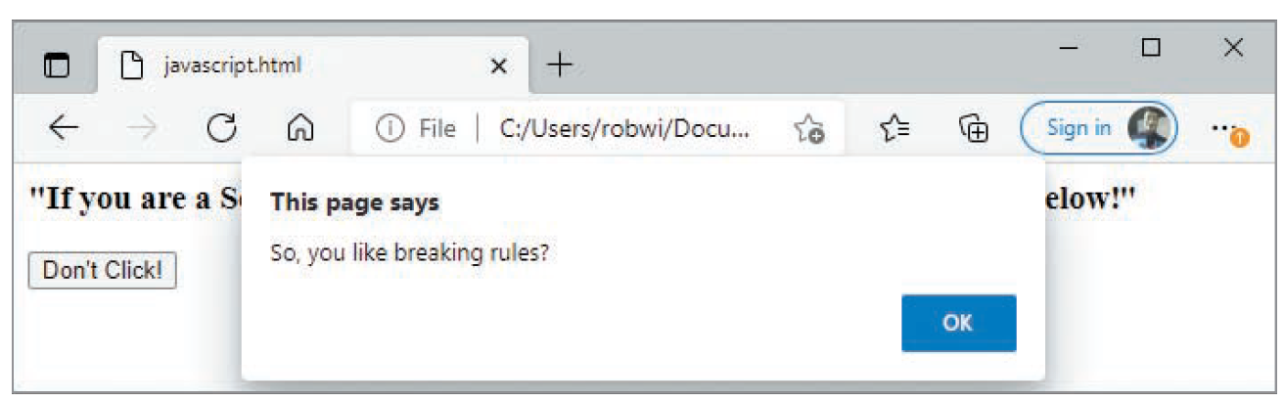
JavaScript (4 of 4)
Source: Cengage
Figure 10-6 A command button created with JavaScript
Source: Cengage
Figure 10-7 An alert message created with JavaScript

Slide 23
Connecting to Databases
Most webpages that display company information to users are stored on a database server
The technology used to connect a web application to a database server might vary depending on the OS
But the theory is the same

Slide 24
Open Database Connectivity
Open Database Connectivity (ODBC)
A standard database access method developed by the SQL Access Group
ODBC interface
Allows an application to access data stored in a database management system (DBMS), or any system that can recognize and issue ODBC commands
Interoperability is accomplished by defining the following:
Standardized representation for data types
Library of ODBC function calls that allow an application to connect to a DBMS, run SQL statements, and retrieve the results
Standard method of connecting to and logging onto a DBMS

Slide 25
Object Linking and Embedding Database (OLE DB)
OLE DB
Set of interfaces that enable applications to access data stored in a DBMS
Designed by Microsoft
Faster, more efficient, and more stable than ODBC
Relies on connection strings that allow the application to access data stored on an external device
Different providers can be used
Depends on the data source

Slide 26
OLE DB Providers (1 of 2)
OLE DB provider | Description in connection string
Microsoft Active Directory Service | Provider=ADSDSOOBJECT
Advantage | Provider=Advantage OLE DB Provider
AS/400 (from IBM) | Provider=IBMDA400
AS/400 and VSAM (from Microsoft) | Provider=SNAOLEDB
MS Commerce Server | Provider=Commerce.DSO.1
DB2 | Provider=DB2OLEDB
Microsoft Jet | Provider=Microsoft.Jet.OLEDB.4.0
Microsoft.ACE | Provider=Microsoft.ACE.OLEDB.12.0 MS Exchange

Slide 27
OLE DB Providers (2 of 2)
OLE DB provider | Description in connection string
MySQL | Provider=MySQLProv
Oracle (from Microsoft) | Provider=msdaora
Oracle (from Oracle) | Provider=OraOLEDB.Oracle MS SQL
MS SQL Server | Provider=SQLOLEDB

Slide 28
ActiveX Data Objects
ActiveX Data Objects (A D O)
A programming interface for connecting a web application to a database
Defines a set of technologies that allow applications to interact with the web
Steps for accessing a database from an ASP webpage:
Create an A D O connection to the database you want to access
Open the database connection you created in Step 1
Create an A D O recordset
Open the recordset
Select the data you need from the recordset, based on particular criteria
Close recordset and database connection

Slide 29
Knowledge Check Activity 10-1
Which of the following can be used to create dynamic webpages? (Choose all that apply.)
ColdFusion
PHP
ASP
MySQL
Notes:
Instructions:
Use the Knowledge Check questions to periodically pose a question to students during class to gauge how well they can recall the material that was presented.

Slide 30
Knowledge Check Activity 10-1: Answer
Which of the following can be used to create dynamic webpages?
Answer: a., b., and c. ColdFusion, PHP, and ASP
Dynamic webpages can be created with a variety of techniques, including CGI, ASP.NET, ASP, PHP, ColdFusion, and JavaScript.

Slide 31
Polling Activity 10-1
Which of the following is an open source technology for creating dynamic HTML webpages?
ASP
PHP
Java
Oracle
Notes:
Instructions:
1. Use this activity to solicit student opinions about concepts in the module or to play a game.
2. Go to kahoot.com, or the platform of your preference, and log in or sign up.
3. Create the challenge.
4. Teacher Tip: Turn off the timer to prioritize accuracy or turn on the nickname generator to avoid inappropriate nicknames.
5. Invite players by sharing the link or PIN.
6. This can be done synchronously during class or asynchronously for review or homework.

Slide 32
Polling Activity 10-1: Answer
Which of the following is an open source technology for creating dynamic HTML webpages?
Answer: b. PHP
PHP Hypertext Processor (PHP) enables web developers to create dynamic webpages.

Slide 33
Discussion Activity 10-1
CGI is used in Microsoft ASP pages. True or false?
Also, discuss various web application components with your classmates.
Notes:
Instructions:
Use the Discussion activity to encourage group conversation about a related topic of interest.

Slide 34
Discussion Activity 10-1: Answer
CGI is used in Microsoft ASP pages. True or false?
Answer: False
Explanation: Microsoft uses ASP, which enabled developers to build dynamic, interactive webpages using scripting languages, such as JScript (Microsoft’s version of JavaScript) or VBScript. It did not use CGI.

Slide 35
Understanding Web Application Vulnerabilities
Many platforms and programming languages can be used to design a website
Regardless of the platform, security professionals need to assess the system and examine potential methods for attacking it
Application security
As important as network security
Referred to as AppSec
Was once overlooked by professionals because it is specialized practice
Attackers controlling a web server can:
Deface the website
Destroy the application’s database or sell its contents
Gain control of user accounts
Perform secondary attacks from the web server
Gain access to other servers that are part of the network infrastructure

Slide 36
Application Vulnerabilities and Countermeasures (1 of 6)
Open Web Application Security Project (OWASP)
Not-for-profit organization
Finds and fights the causes of web application vulnerabilities
Publishes the “Ten Most Critical Web Application Security Risks” paper
Built into the Payment Card Industry (PCI) Data Security Standard (DSS)
A security tester might need to analyze vulnerabilities such as the following in the OWASP Top 10 list:
Injection vulnerabilities
Authentication flaws and weaknesses
Sensitive data exposure
XML external entities (XXE)
Broken access control
Security misconfigurations

Slide 37
Application Vulnerabilities and Countermeasures (2 of 6)
Cross-site scripting (XSS)
Insecure deserialization
Using components with known vulnerabilities
Insufficient logging and monitoring
OWASP
Offers Broken Web Apps and WebGoat
Webgoat: An online utility that helps beginning security testers understand the web application vulnerabilities covered in this list
WebGoat project
Helps security testers learn how to conduct vulnerability testing on web applications
Experts from all over the world use WebGoat and offer their input
The following slides contain images of WebGoat

Slide 38
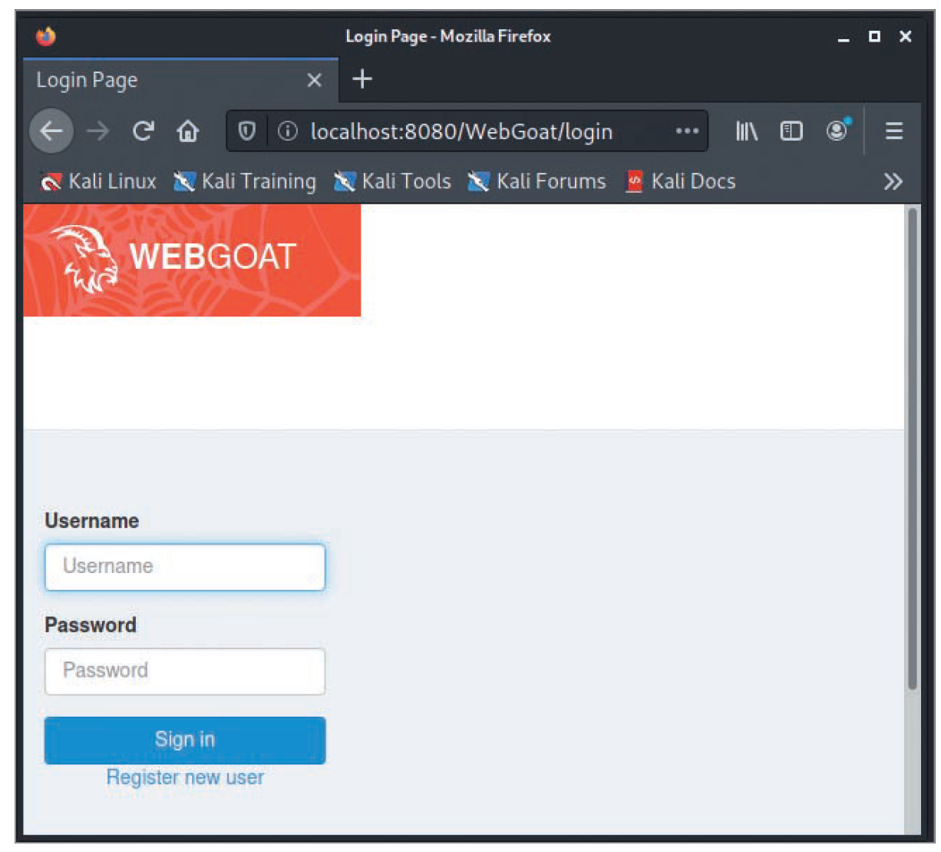
Application Vulnerabilities and Countermeasures (3 of 6)
Source: OWASP Foundation
Figure 10-8 WebGoat start page

Slide 39
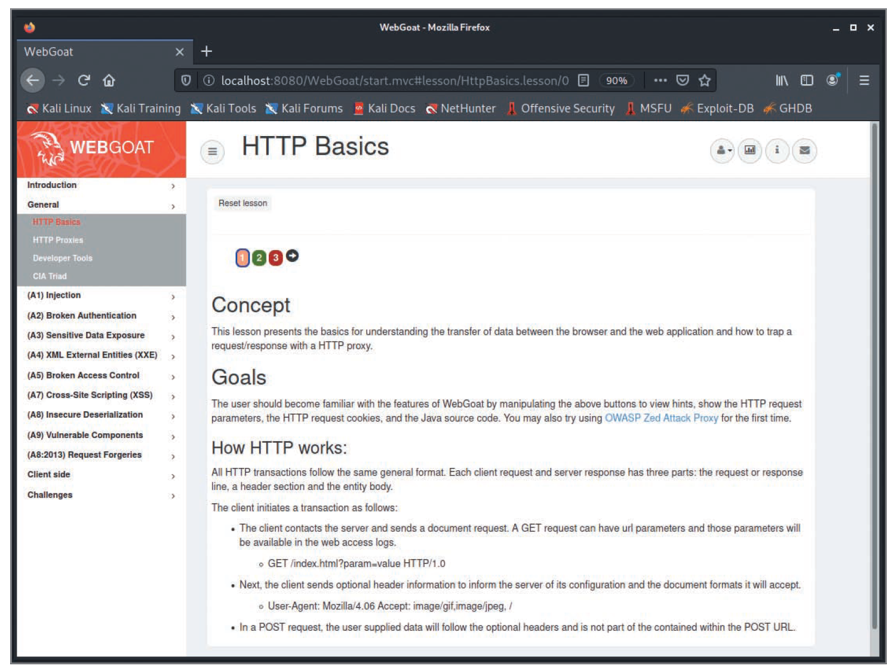
Application Vulnerabilities and Countermeasures (4 of 6)
Source: OWASP Foundation
Figure 10-10 WebGoat HTTP Basics exercise

Slide 40
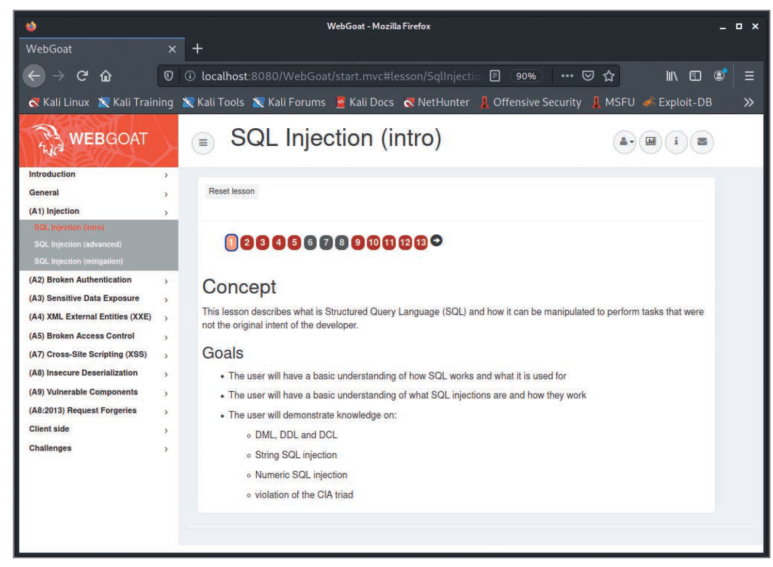
Application Vulnerabilities and Countermeasures (5 of 6)
Source: OWASP Foundation
Figure 10-11 WebGoat SQL Injection (intro) exercise

Slide 41
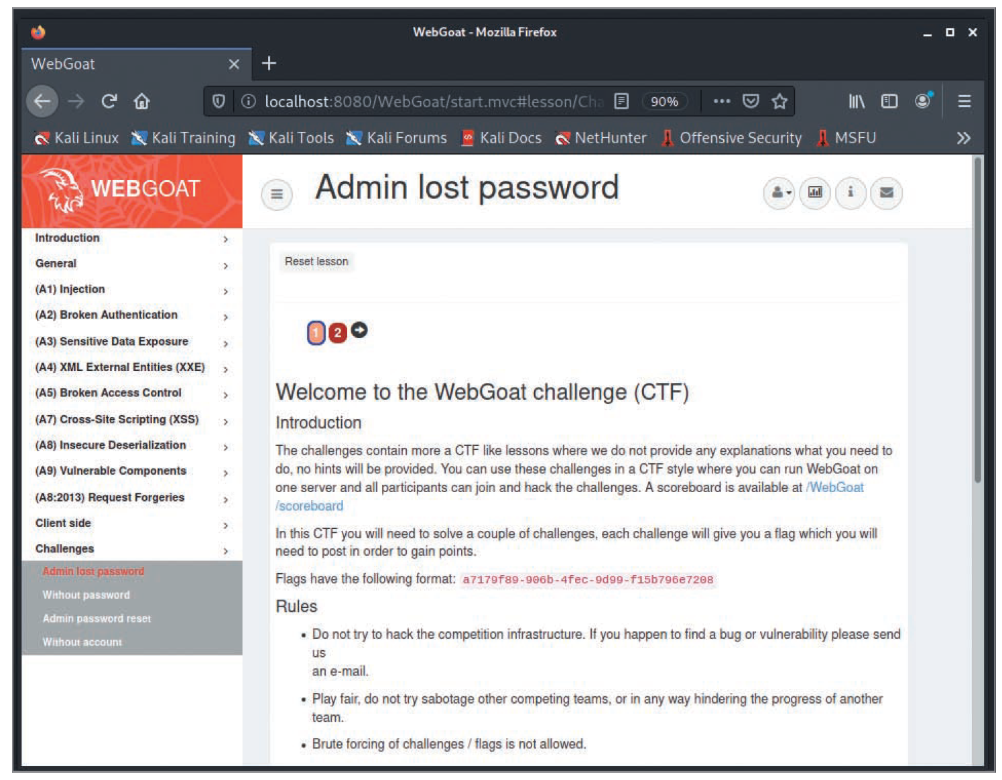
Application Vulnerabilities and Countermeasures (6 of 6)
Source: OWASP Org
Figure 10-12 WebGoat Challenges page

Slide 42
Web Application Test Execution
Two techniques by which an application can be tested:
Static Application Security Testing (SAST)
Analyzing an application’s source code for vulnerabilities
Only possible when the source code is available
A reliable way to enumerate most application vulnerabilities
Dynamic Application Security Testing (D A S T)
Analysis of a running application for vulnerabilities
Can be used alongside SAST to prioritize SAST findings
Other technique
Interactive Application Security Testing (IAST)
Combines elements of both SAST and D A S T
Uses an agent inside the application to perform its analysis in real-time at any point in the development process

Slide 43
Information Gathering and Architecture Mapping
Security testers should look for answers to some important questions:
Does the application have a database?
Does the application require authentication?
Does the application have static or dynamic pages?
What languages and platform does the application use?
Are there devices between your web browser and the application designed to stop attacks from occurring?
How does data flow in the application?

Slide 44
Platform Security and Configuration
Several different platforms and technologies can be used to develop web applications
Attacks differ depending on platform and technology
Footprinting is used to discover the OS and DBMS that the attacked system is using
The more you know about a system, the easier it is to gather information about vulnerabilities and common misconfigurations
Questions to consider during this phase:
Do the underlying platforms and components contain known vulnerabilities?
Is the web server configured to protect the confidentiality of users who connect to it?
Are there administrative interfaces to the infrastructure components and the applications being tested?

Slide 45
Authentication and Session Testing
Many web applications require that a server other than the web server authenticate users
Examine how information is passed between the two servers
Is an encrypted channel used or is data passed in cleartext?
Is the server used for authentication properly configured and patched?
Are logon and password information stored in a secured location?

Slide 46
Authorization Testing
Authorization
The act of checking a user’s privileges to allow or deny access to a page, field, resource, or action in an application
Application developers
Commonly use hidden fields in tables and obscured URLs to enforce their access control instead of checking users’ privileges
Authorization testing can reveal major areas of concern
An important part of any application test

Slide 47
Input Validation (1 of 3)
Input validation
The act of filtering, rejecting, or sanitizing a user’s untrusted input before the application processes it
Input validation problems can lead to
Data disclosure
Alteration
Destruction
Security testers should check for possibility of SQL injection used to attack the system
SQL injection (SQLi): Attacker supplies SQL commands when prompted to fill in a web application field

Slide 48
Input Validation (2 of 3)
SQL injection example:
SELECT * FROM customer
WHERE tblusername = ' OR 1=1 - - AND tblpassword = ' '
Because 1 equals 1 is always true, the query is carried out successfully
Double hyphens (--) are used in SQL to indicate a comment

Slide 49
Input Validation (3 of 3)
Security testers should test any web applications when performing a security test and are authorized in writing to do so
Basic testing should look for:
Whether you can enter text containing punctuation marks of any kind
Whether you can enter a single quotation mark followed by any SQL keywords
Whether you can get any sort of database error when attempting to inject SQL statements
Sometimes, a web application will give a tester no indication that a SQL statement was run
OWASP calls this “Blind SQL injection” and it has its own set of tests that are required for detection

Slide 50
Error Handling
A web application can be configured or written to handle errors in a variety of ways
Developers can enable debugging
Provides rich logging information helpful to diagnose issues
If the debugging mode is left on, it can provide a rich source of information for attackers
Developers should minimize the amount of information shared with users when an application encounters an error
No information or only a generic message should be displayed to users in these error cases

Slide 51
Cryptography Testing
Many problems in cryptography are due to simple things:
Bad random number generators
A known weak method of encryption
An encryption algorithm with known flaws that allow it to be cracked
An application that doesn’t actually enforce the use of secure channels
A self-signed certificate instead of a purchased certificate

Slide 52
Business Logic Testing
Business logic
Refers to the procedure a user is expected to follow in an application to accomplish a goal
Example:
Before a wire transfer, a user must first satisfy the requirement of having at least that amount of money in the transferring account
If the user doesn’t have adequate funds, the transfer should be halted
Business logic testing
Involves using creative ways to bypass these types of checks

Slide 53
Client-Side Testing
Client-side issues
Arise from code executing on the user’s machine, typically within the web browser
Client-side controls
Insufficient on their own and should be paired with server-side controls that cannot be bypassed
Key questions to ask with a client-side test are as follows:
Does the application store sensitive information on the client’s machine in an insecure manner?
Does the application allow for client browser redirection if the server is fed a specially crafted request?

Slide 54
Polling Activity 10-2
What is D A S T?
Dynamic Application Static Testing
Dynamic Application Server Takeover
Delivery Application Server Testing
Dynamic Application Security Testing
Notes:
Instructions:
1. Use this activity to solicit student opinions about ethical hacking and related concepts in the module or to play a game.
2. Go to kahoot.com, or the platform of your preference, and log in or sign up.
3. Create the challenge.
4. Teacher Tip: Turn off the timer to prioritize accuracy or turn on the nickname generator to avoid inappropriate nicknames.
5. Invite players by sharing the link or PIN.
6. This can be done synchronously during class or asynchronously for review or homework.

Slide 55
Polling Activity 10-2: Answer
What is D A S T?
Answer: d. Dynamic Application Security Testing
D A S T stands for Dynamic Application Security Testing.

Slide 56
Knowledge Check Activity 10-2
Entering the value ' OR 1 = 1 in a web application that has an “Enter Your PIN” field is most likely an example of which attack?
SQL injection
Code injection
Buffer overflow
Ethernet flaw
Notes:
Instructions:
Use the Knowledge Check questions to periodically pose a question to students during class to gauge how well they can recall the material that was presented.

Slide 57
Knowledge Check Activity 10-2: Answer
Entering the value ' OR 1 = 1 in a web application that has an “Enter Your PIN” field is most likely an example of which attack?
Answer: a. SQL injection
In SQL injection (SQLi), the attackers insert (“inject”) their own SQL statements within the “Enter Your PIN” field in a web application. Because 1 = 1 is always true, the query is carried out successfully.

Slide 58
Tools for Web Attackers and Security Testers
After vulnerabilities of a web application or an OS platform are discovered, security testers or attackers look for tools to test or attack the system
All platforms and web application components have vulnerabilities
No matter which platform is used to develop a web application, there is a security hole that attackers can exploit to break into the system

Slide 59
Web Tools
Most tools for performing a security test or attacking a network can be found on the Internet and are usually free
Kali Linux
Is packed with free tools for hacking web applications
You can install new tools with a simple apt-get install packagename command
Other tools might be more suitable for a specific task

Slide 60
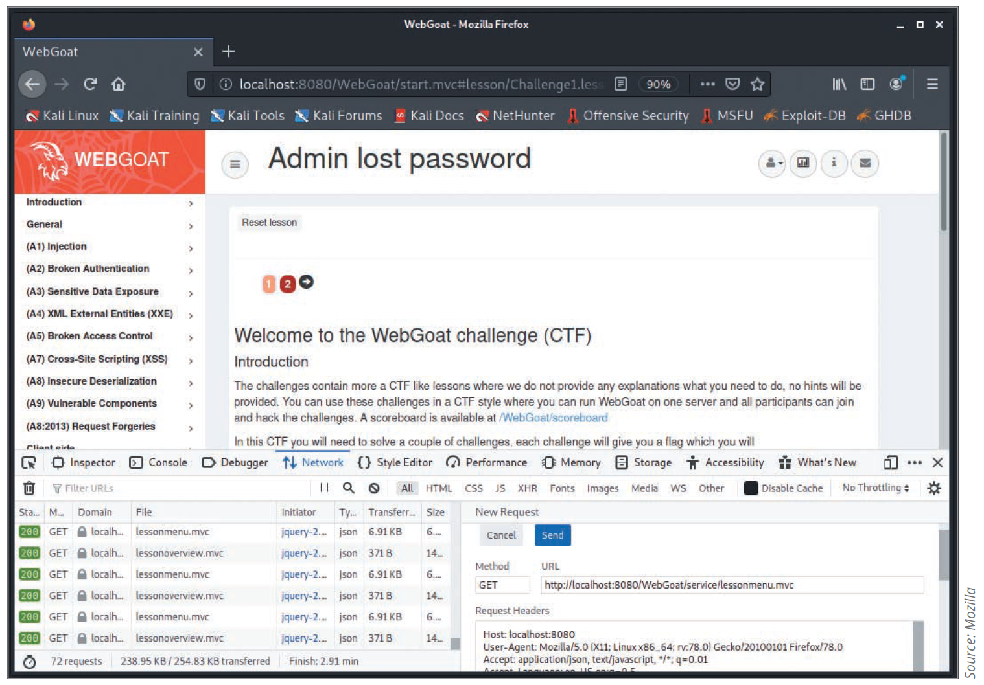
Firefox and Chrome Built-In Developer Tools
Both come with similar set of developer tools
Useful for an application security tester
Allow an attacker to:
View parameters in requests
Examine cookies
Tamper with and resend requests

Slide 61
Burp Suite and Zed Attack Proxy (1 of 2)
Burp Suite
Included in Kali Linux
Offers the tester a number of features for testing web applications and web services
Allows you to intercept traffic between the web browser and the server so that you can inspect and manipulate requests before sending it to the server
Crawl, scan, and use brute force on applications
Zed Attack Proxy
Can be used interchangeably with Burp Suite

Slide 62
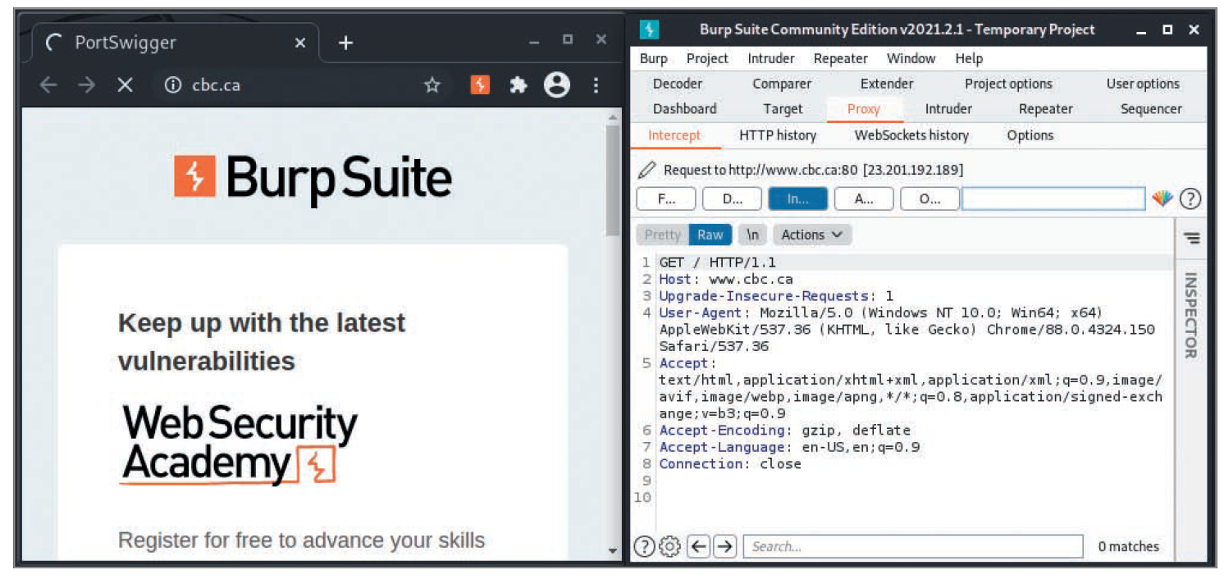
Burp Suite and Zed Attack Proxy (2 of 2)
Source: Burp Suite
Figure 10-14 Burp Suite intercepting proxy

Slide 63
Wapiti
Web application vulnerability scanner
Uses a black box approach
Doesn’t inspect code
Inspects a website by searching from the outside
Ways to take advantage of XSS, SQL, PHP, JSP, and file-handling vulnerabilities
Uses “fuzzing”
Trying to inject data into whatever will accept it

Slide 64
Self-Assessment
Recall the differences between Common Gateway Interface (CGI ) and Active Server Pages (ASP).
Describe the different types of scripting languages used to develop webpages.
Notes:
Instructions:
Use the Self-Assessment question to encourage students to evaluate their progress or goals in the course, as well as determine how they might apply their learning or grow as an individual.

Slide 65
Summary
Now that the lesson has ended, you should be able to:
Describe web applications
Explain web application vulnerabilities
Describe the tools used to attack web servers

